Slide 1
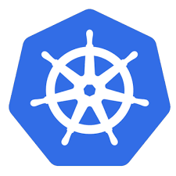
Kubernetes Introduction

Slide 2
Agenda
What is Kubernetes ?
What problem does it solve ?
Kubernetes Architecture
K8s Components
Example

Slide 3
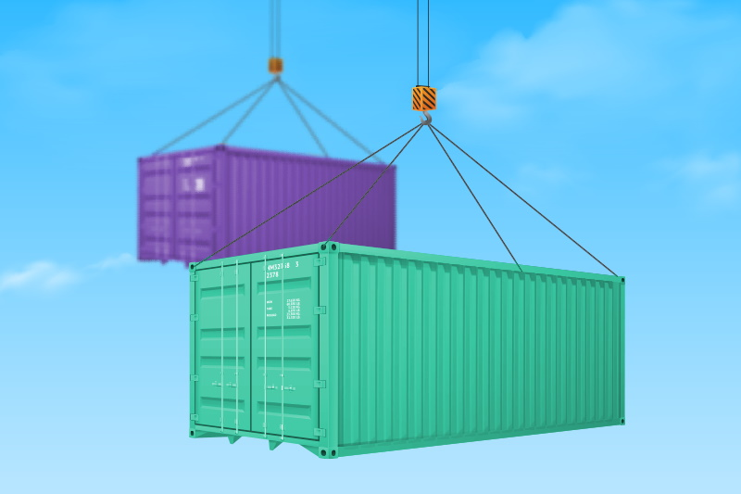
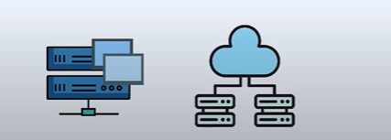
What is Kubernetes ?
Open-source container orchestration tool
Developed by Google
Helps manage containerized applications
in different deployment environments

Slide 4

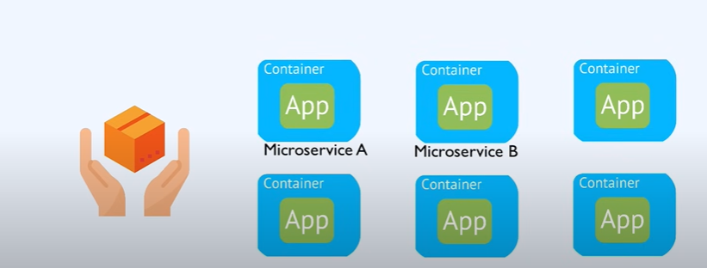
What Problem K8S solves ?
Need for container orchestration tool
Trend from Monolith to Microservices Architecture.
Increased usage of Containers.
Demand for a proper way of managing those hundreds of containers

Slide 5
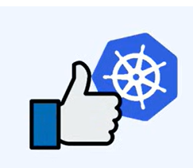


What features does orchestration tool offer ?
High Availability or no downtime
Scalability or high performance
Disaster recovery - backup and restore

Slide 6
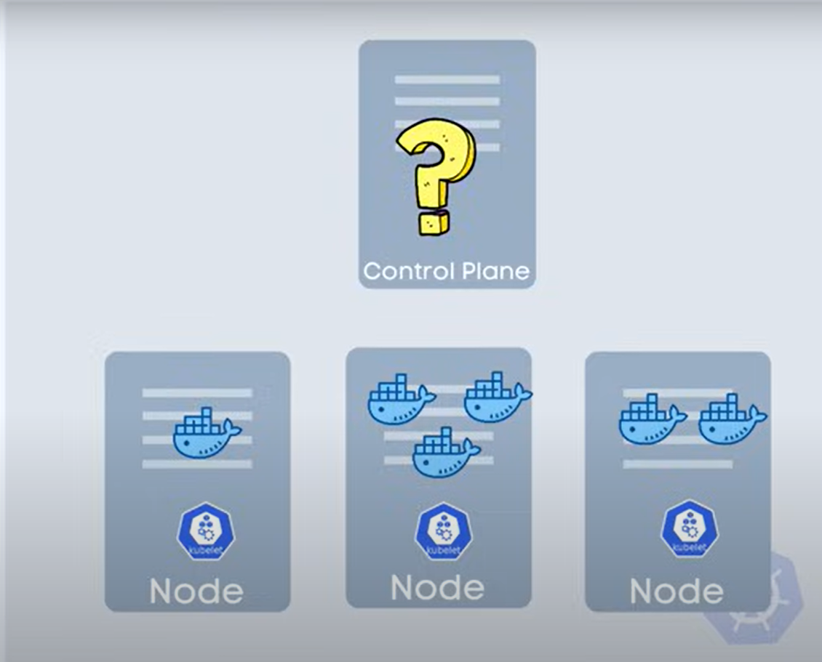
Kubernetes Architecture
On master node the necessary processes are running !
On worker node the applications are running

Slide 7
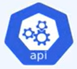
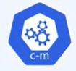


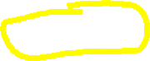
UI
API
CLI
API Server – Entry point to K8s Cluster
API Server
Controller Manager – Keeps track of what's happening in the cluster
Controller Manager
Scheduler – ensures pods placement
Scheduler
30% Used
60% Used
Where to put the new Pod ?
Control Plane
Pod
Scheduler decides on which Node the new pod should be scheduled.
Node
Node

Slide 8
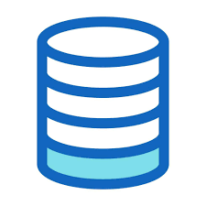

UI
API
CLI
API Server – Entry point to K8s Cluster
API Server
Controller Manager – Keeps track of what's happening in the cluster
Controller Manager
Scheduler – ensures pods placement
Scheduler
etcd
etcd – Kubernetes backing store
Control Plane

Slide 9
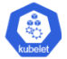
UI
API
CLI
API Server
Controller Manager
Virtual Network – Enables Nodes communicate with each other / creates one unified machine.
Scheduler
etcd
Control Plane
Virtual Network
Node
Node
Node

Slide 10
UI
UI
API
CLI
API
CLI
Control Plane Nodes
Handful of master processes
API Server
API Server
Much more important
Controller Manager
Controller Manager
Scheduler
Scheduler
etcd
etcd
Control Plane
Control Plane
Virtual Network
Worker Nodes
Higher workload
Much bigger and more resources
Node
Node
Node

Slide 11
Main Kubernetes Components
Node
my-app
Pod
StatefulSet
ConfigMap
Service
DaemonSet
Secret
DB
Ingress
Deployment
Node

Slide 12
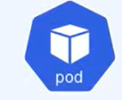
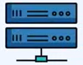
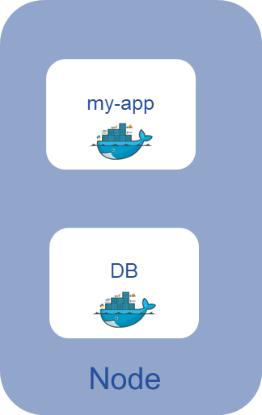



Node and Pod
Physical or Virtual Machine
Smallest unit in Kubernetes
Abstraction over container
Usually 1 application per pod
Each pod gets its own IP address
New IP on re-creation
IP
Pods are ephemeral !!
DB
IP
New Pod
Pod
Container

Slide 13

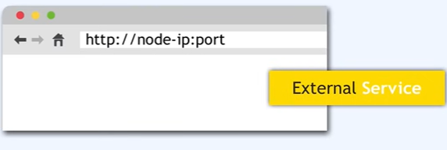

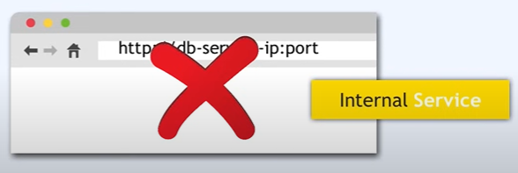
Service
App should be accessible through browser
Permanent IP Address
Lifecycle of Pod and Service not connected
Service
Service
you specify the type of the service at the time of creation
By default – Internal Service
You specify the type of service on creation
Internal Service is the default type

Slide 14
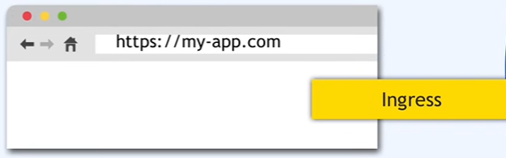
Ingress…
Ingress
Service
https://124.80.104.101:8080
https://my-app.michelin.com
Service

Slide 15
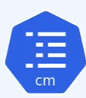
ConfigMap
DB_URL = Postgre_Sql_Service
ConfigMap
External Configuration of your application
E.g. DB URL
ConfigMap is only for non-confidential data only !!
Service
Changed to PostgreSql
Service
Username
Password

Slide 16


Secret
DB_URL = Postgre_Sql_Service
Secret
ConfigMap
Used to store secret data
Credentials
Certificates
Reference secret in deployment/pod
Stored in 3rd-party encrypted format
Use it as Environment Variable or as Properties file
Service
DB_USER = Username
DB_PWD = Password
Changed to PostgreSql
Service
Username
Password

Slide 17
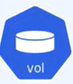
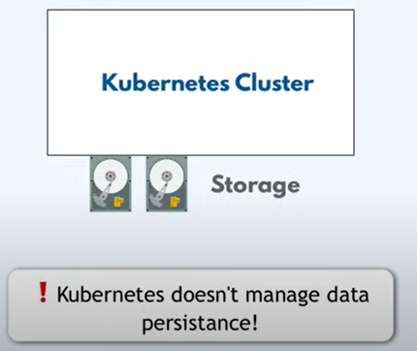

Volume
Storage on local machine
or remote, outside of K8s cluster
Cloud or own-premise server
Service
Service
Volume
Local/Remote Storage
DB Pod restarted ??

Slide 18
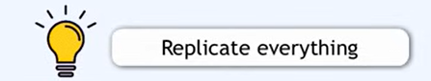
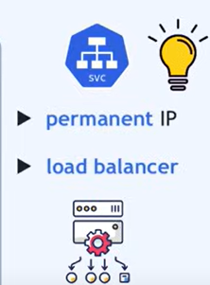
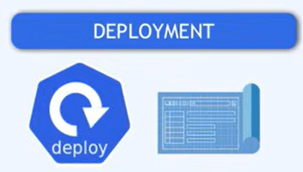
Deployment
What if my-app Pod dies or restarted ?
Downtime – in prod ?
Service is connected to same service.
Define a blueprint for pods - Deployment
Specify how many replicas
You create Deployments
Abstraction on pod
Service
Service

Slide 19


Deployment
Avoid Downtime
Service
Service

Slide 20
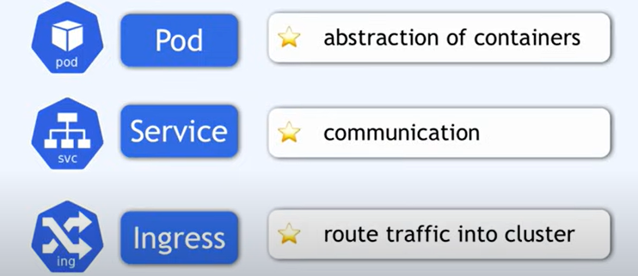
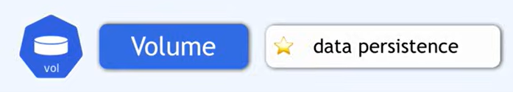
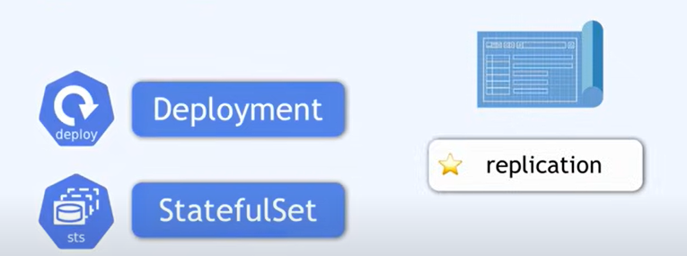
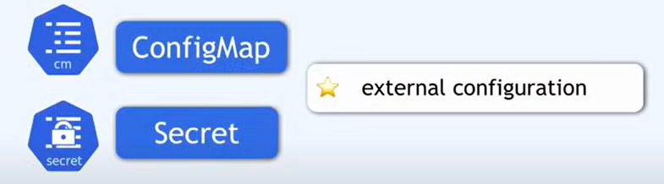
Summary K8s Components

Slide 21
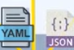
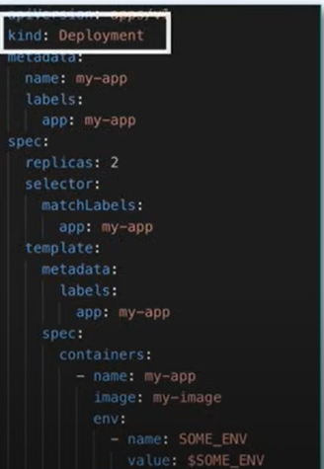
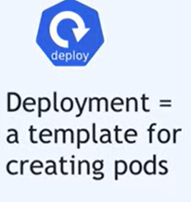
Kubernetes Configuration
UI
API
CLI
Declarative format
Is == Should
Controller Manager checks:
desired state == actual state
API Server
Controller Manager
Scheduler
etcd
Control Plane

Slide 22
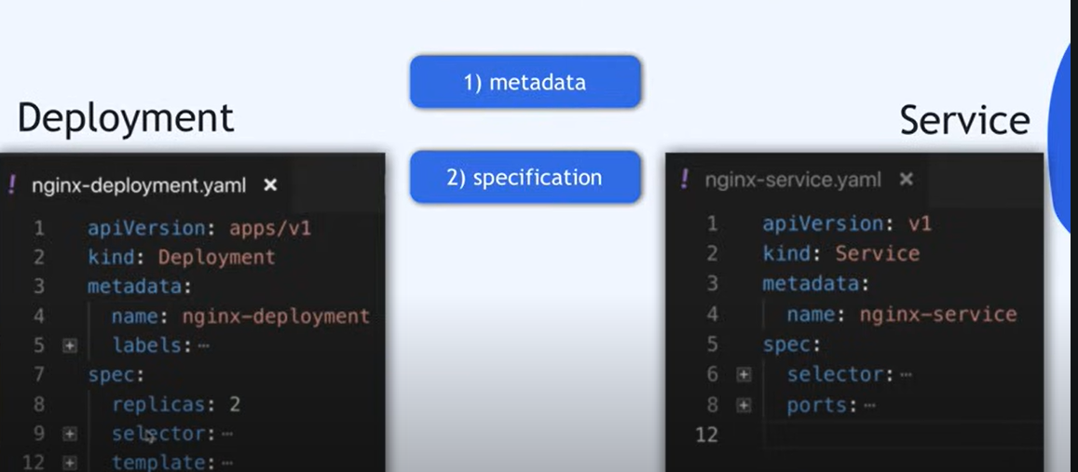
3 parts of Configuration file

Slide 23
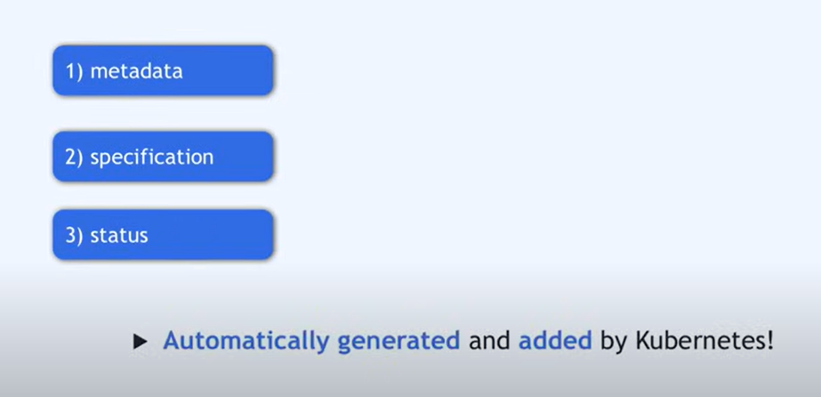
3 parts of Configuration file

Slide 24
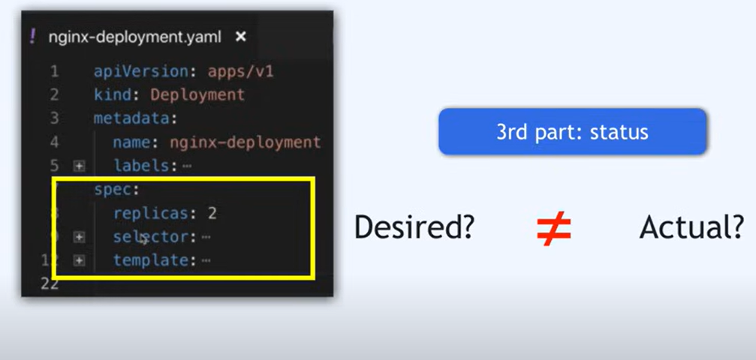
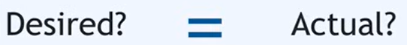
3 parts of Configuration file
Self healing feature

Slide 25
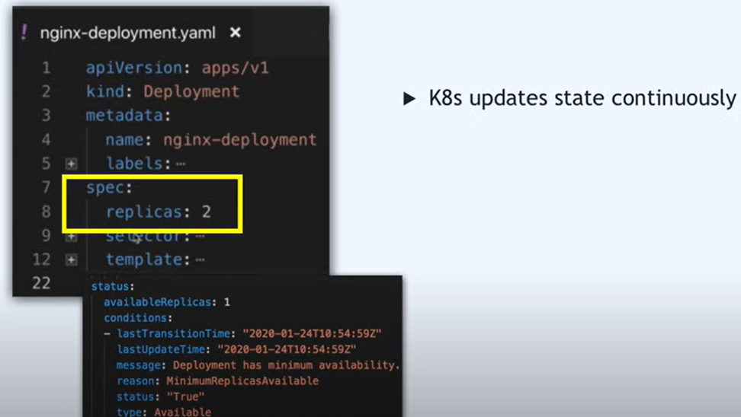
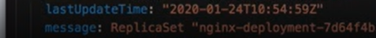
3 parts of Configuration file

Slide 26
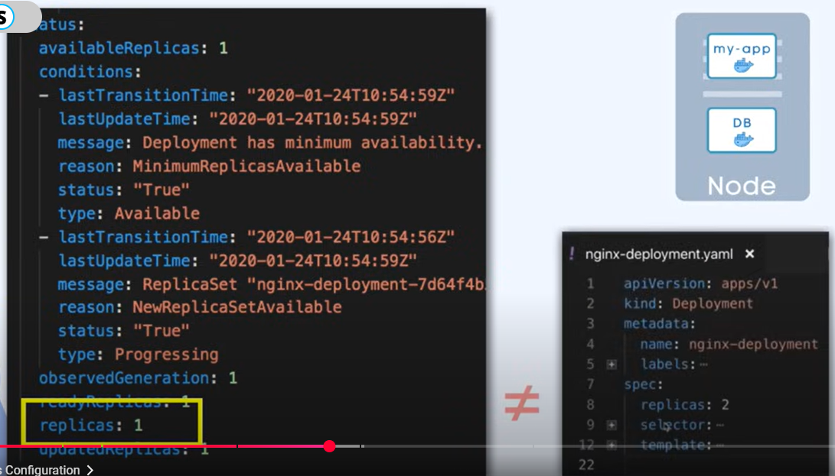
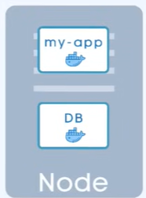
3 parts of Configuration file

Slide 27
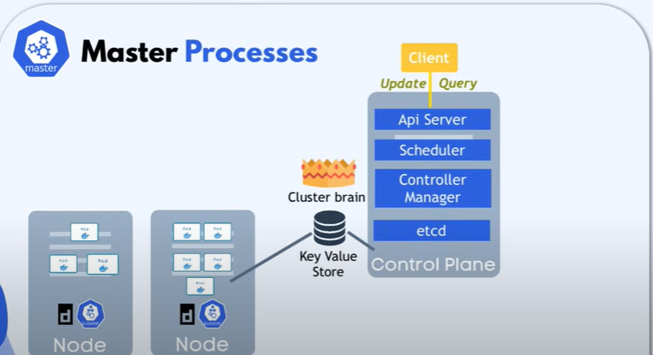
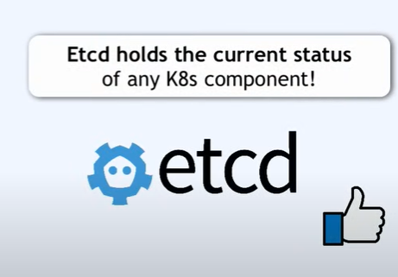
Where does the K8s get this Status Data ?

Slide 28
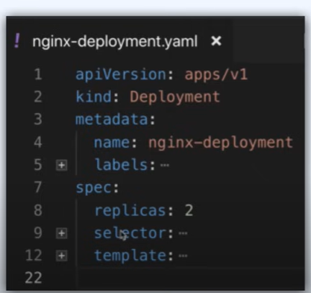
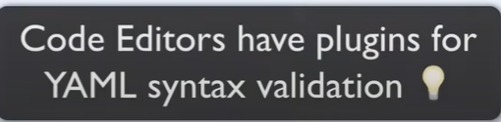
YAML configuration file
human friendly data serialization standard for all programming languages
Syntax: strict indentation
Store the config file with your code

Slide 29
Example

